Slide 1
Further analysis on Choice dynamic
October 2024

Slide 2
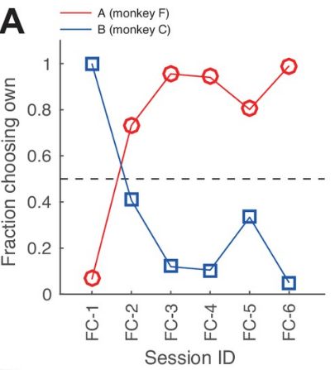
Statistical test and learning effect
1) With Igor and Sebastian find the explanation for miscoordination when monkey was second (Sahra’s suggestion: rule checking)
2) Exact Fischer test on FCO between timings and between data sets (before and after getting trained with human conf, before and after introducing 3 Go sig)
3) recreate this plot based on timing and before/ after training with human confederate

